Slide 1
OpenLAB CDS
What’s new in OpenLAB CDS X.01.05
Steve Miller June 27 2013
Notes:
1

Slide 2
OpenLAB CDS Vision
ChemStation
Better
OpenLAB EE/CS editions
Goal:
Unified Data Product
Easier
EZChrom
Faster
Notes:
High level overview of the vision for OpenLAB CDS in general. Consolidation of multiple chromatograpy platformes that exist in Agilent into a single platform: OpenLAB CDS
Focus on simple migration from old to new platform.

Slide 3
OpenLAB CDS Vision Where we stand today
ChemStation B.04.0x
EZChrom 3.3.x
Today
Uniform Drivers (RC.NET)
Uniform Reporting (Intelligent Reporting)
Uniform
Data Analysis
OpenLAB CDS A.01.01
C.01.01 ChemStation Edition
A.04.01 EZChrom Edition
Notes:
Final Goal: A single new OpenLAB CDS with the best of the old – renew, modern , productive
We focus on smooth migration to take existing customers with us – old and new co-exists for a while so customer can move at their own pace.
Phase 1 has been the migration of both EZChrom and ChemStation to RC.NET instrument driver technology. Both platforms share the same instrument control technology
Phase 2 was the introduction of the OpenLAB Intelligent Reporting; both platforms now have the ability to run the same reporting engine and exchange report templates
TODAY Phase 3: The introduction of OpenLAB Data Analysis where both platforms share the same data analysis engine
Tomorrow: Phase 4: Have both platforms work on the same acquisition engine (sequences etc.), by then there will be no separate platforms anymore!

Slide 4
What is New in OpenLAB ChemStation C 1.05 and OpenLAB EZChrom 4.05

Slide 5
OpenLAB CDS .0X.05 ChemStation and EZChrom
7890B Series GC Support Drivers
Integrated Intelligence
• New Resource Conservation (Sleep/Wake)
• New Early Maintenance Feedback (EMF)
• Barcode Scanning with Auto-Input
Improved handling of ALS errors
Agilent Parts Finder
• Updated Column Configuration, including the ability to lock the column
• Support for the 7667A Mini TD
• New Calculator Integration into the method editor
• Updated Columns Database
• New Syringe and Liner Databases
• New Keypad Lock Options
Deployment
Better migration support for mixed systems ChemStation rev. B/ OpenLAB CDS ChemStation Edition on one ECM [CS]
Better migration support allows "mixed version" clients on the latest OLSS server
Mixed topology of Networked Workstations on a Distributed System (AIC)
Customer Experience
Single Sample Method Loading [CS]
Acquisition Method Viewer: Review methods without loading a method to the instrument and without triggering method resolution

Slide 6
RC.Net Drivers for additional LC modules
This release also has new LC & CE Drivers configuring Agilent 1260 Prep LC Systems
G1361A - 1260 Isocratic Prep Pump
Prep Pump Cluster of up to 4x G1361A 1260 Isocratic Prep Pumps
G1364A Fraction Collector
Fraction Collector Cluster of up to 3x G1364A/B/C or G5664A Fraction
Collectors AND additionally 1x G1364A/B/C or G5664A as Recovery Fraction Collector
G2258A - 1260 Dual Loop Autosampler
G2260A - 1260 Preparative Autosampler

Slide 8
Integrated IntellIgence

Slide 9
Superior GC Customer Experience Integrated Intelligence: A Smarter GC System
Integrated Intelligence | Customer Benefit
Integrated GC calculators | Develop methods more easily
Barcode Scanning with Auto-Input | Easier configuration
Integrated early-maintenance-feedback | Manage assets more efficiently
3D Interactive Consumable and Parts Finder | Find parts faster & order more easily
Sleep-wake functionality | Lower cost of ownership

Slide 10
ASK
How can I translate methods to a less expensive carrier gas?
ANSWER
Agilent Method Translation Tools

Slide 11
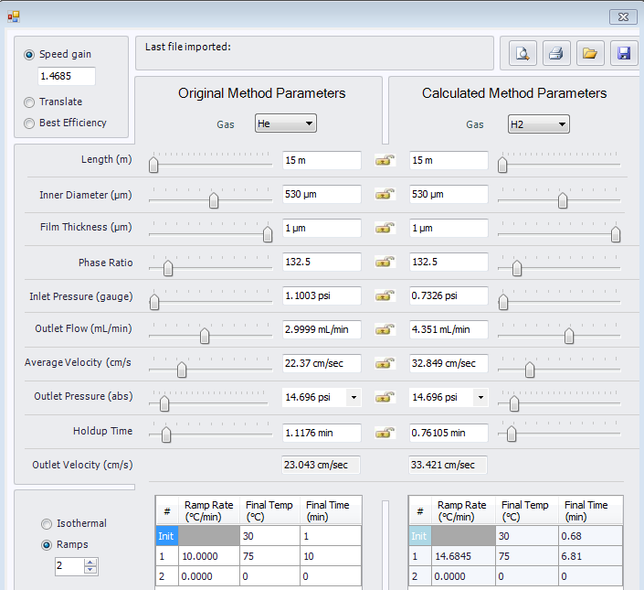
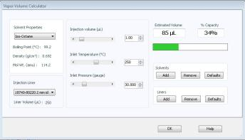
Integrated Method Translation Tools Completely Updated with AutoImport to Method

Slide 12
ASK
How can my 7890 GC help lower power & gas operating costs?
ANSWER
7890B Sleep/Wake Modes

Slide 13
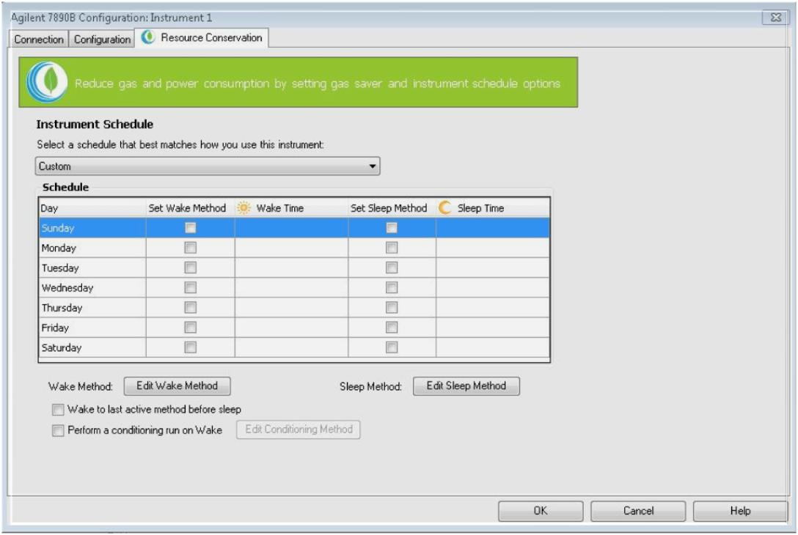
7890B Integrated Sleep/Wake Modes Reduce Power/Gas Costs
Customize sleep-wake protocol:
Example - Condition GC before daily workflow begins
Set sleep and wake times
Define sleep and wake methods

Slide 14
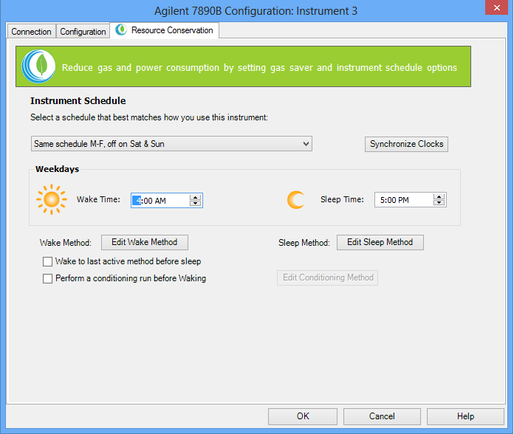
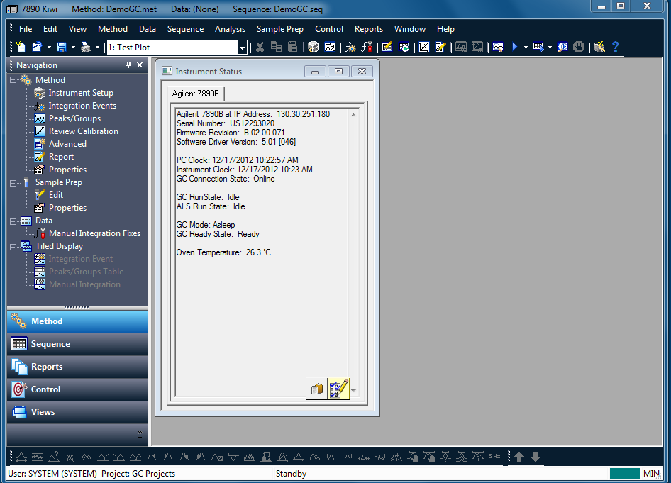
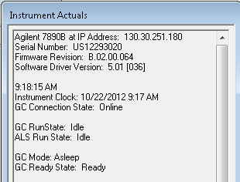
Resource Conservation: Sleep/Wake Mode
Schedule the time of the Wake and Sleep Methods either as “custom”, “7 days a week” or “Sat/Sun”
Manually put the instrument to sleep by clicking on “Sleep” on the “Instrument” menu
Instrument will still go to Sleep or Wake mode even if the data system is not connected for any reason.

Slide 15
ASK
How can I streamline my workflow and track consumables better?
ANSWER
Optional Bar Code Reader

Slide 16
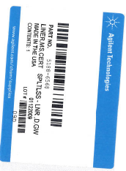
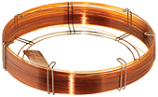
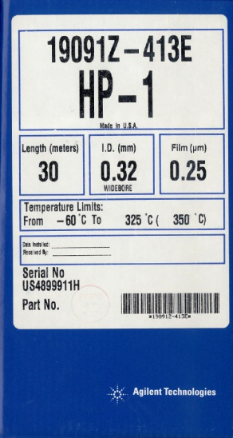
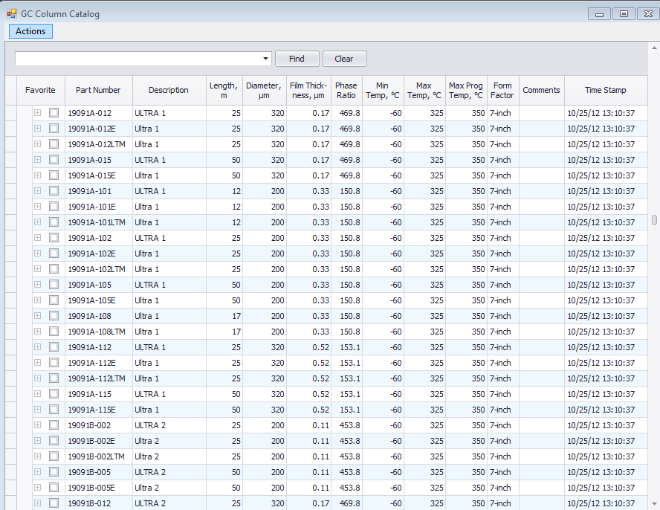
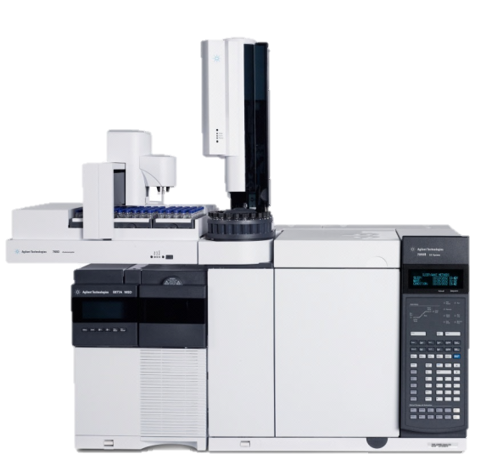
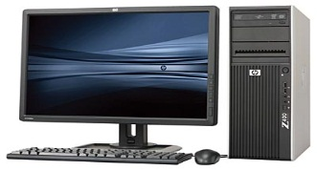
Barcode Scanning
Input
Liners
Columns
Inventory and full Agilent catalog
Periodic updates available
Barcode in the columns, liners, and syringes right into the Agilent data system method
*Also syringes
Notes:
Problem
I need to be able to keep track of columns, liners, and syringes installed in the GC
Solution
Agilent Barcode Scanning Input- Updated Consumables inventory

Slide 17
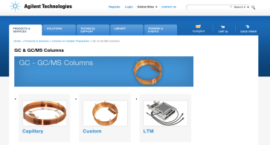
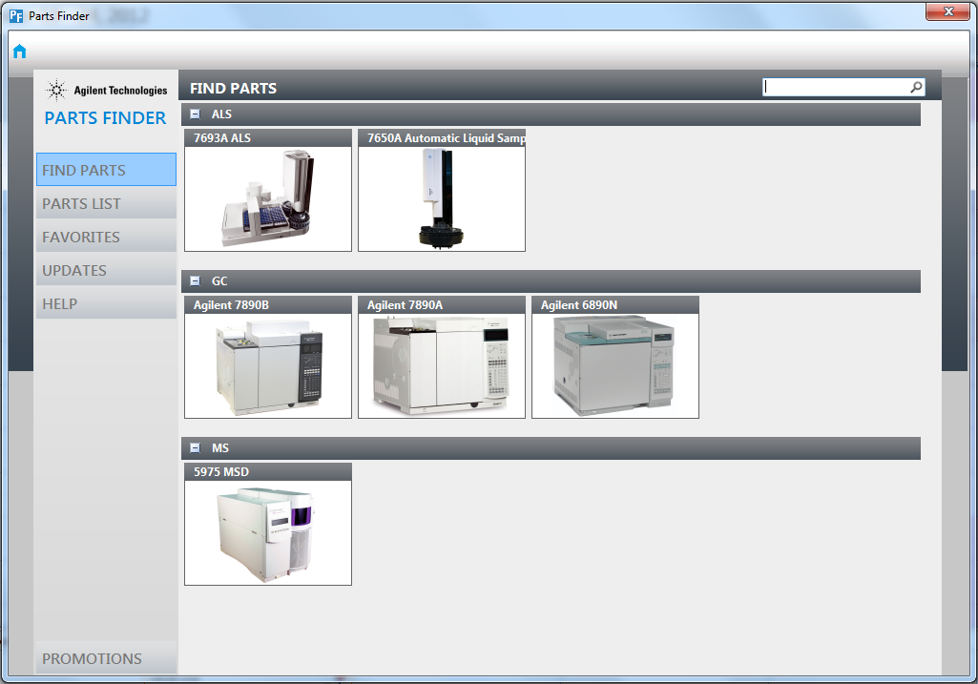
Integrated with Parts Finder Tool
Bar Code Scanning Option
Auto Input column, liner and septum information into method. Integrated with Parts Finder for seamless consumables management.

Slide 18
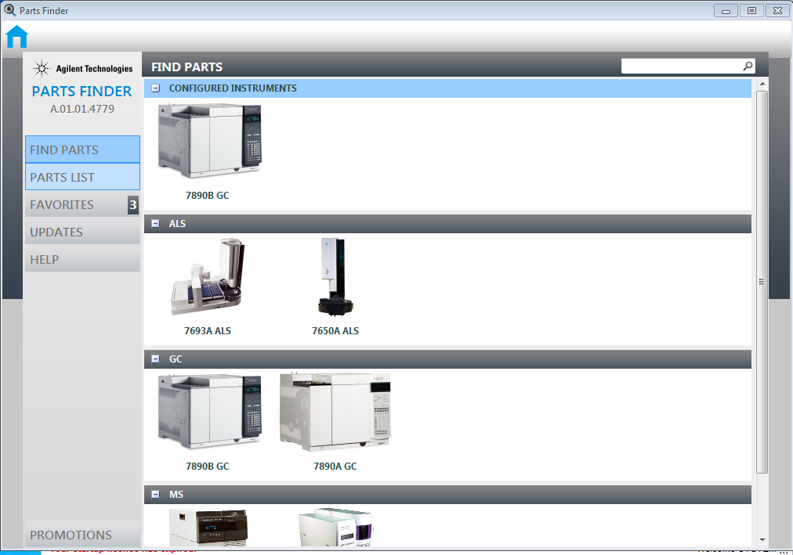
Choose Instrument

Slide 19
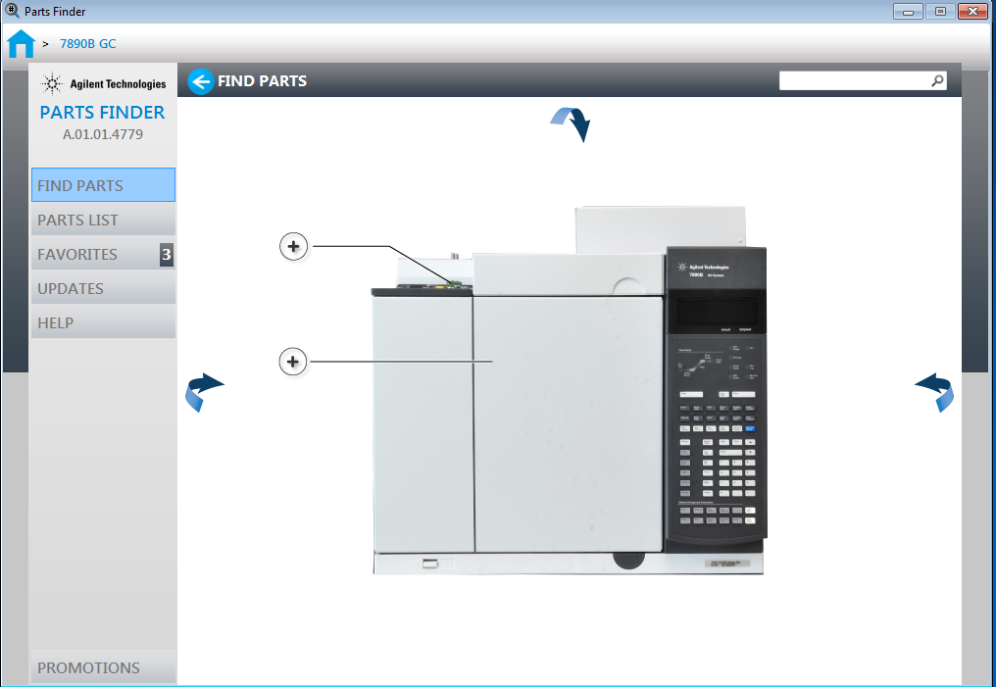
Change rotation and view of instrument

Slide 20
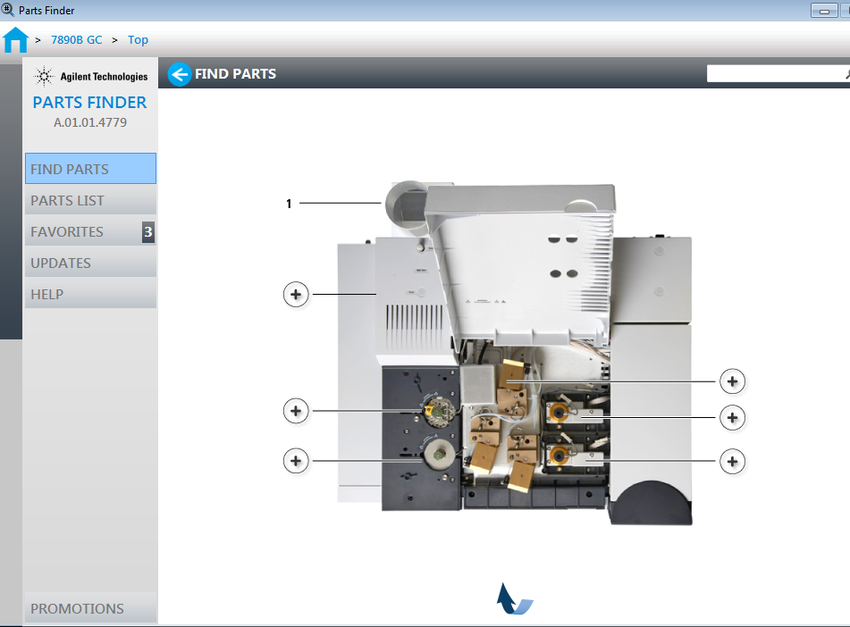
Show the face of the GC and then point to the arrow
Choose inlet or detector

Slide 21
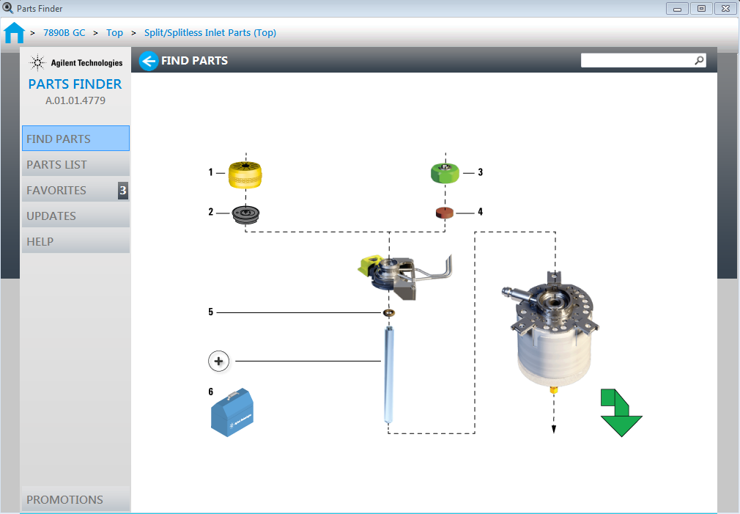
Click on part

Slide 22
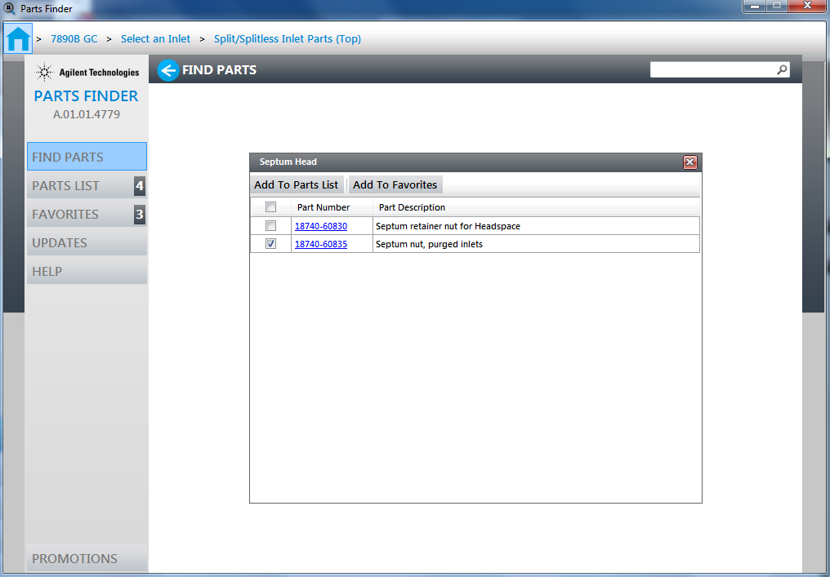
Choose specific part(s) and then add to list

Slide 23
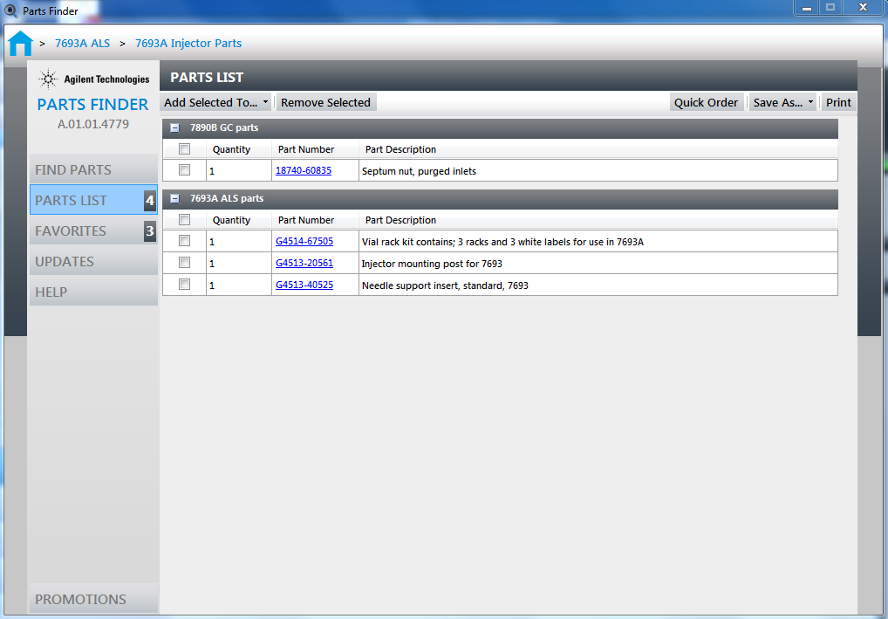
Choose another instrument and parts

Slide 24
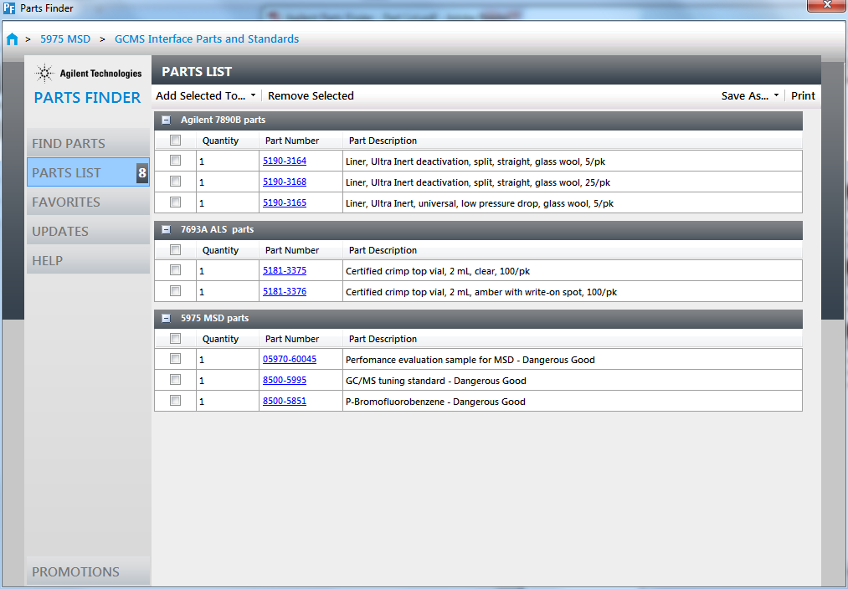
Can do quick order through agilent.com, print list or save list

Slide 25
ASK
How can I optimize maintenance & avoid unplanned downtime?
ANSWER
Agilent Early Maintenance Feedback

Slide 26
Integrated Early Maintenance Feedback
Improving Operational Efficiency
Choose maintenance parameters that are relevant to your own app
Select time-based or frequency-based
counters
Customize user-defined EMF
Example: Check gas cylinder after x injections
Set warning and Action limits

Slide 27
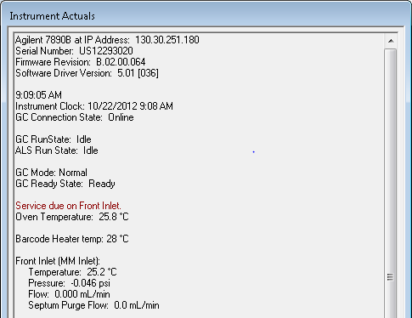
Display of Instrument Actuals
Instrument actuals are displayed next to set-points in the data system.

Slide 28
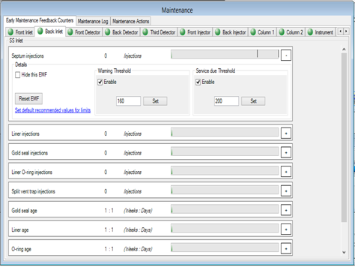
Agilent Early Maintenance Feedback
Set-up the Counters within the Agilent Data Systems
Based on the configuration of the GC
User-defined early maintenance feedback counters
Notification of the Warning and Service Due

Slide 29
ASK
How come my Autosampler didn’t run overnight?
ANSWER
ALS Error Handling Feedback

Slide 30
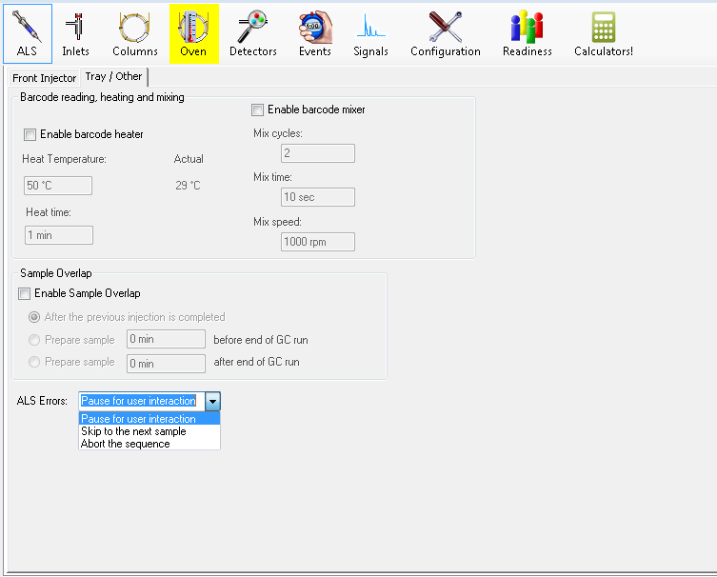
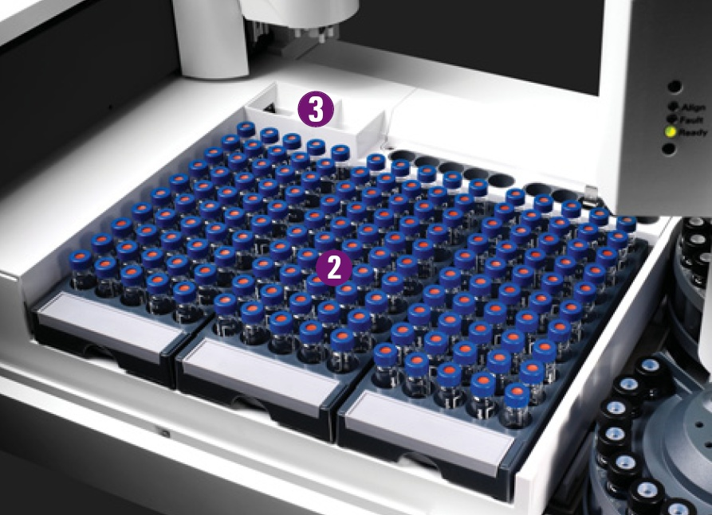
Handling of ALS Errors

Slide 31
ASK
How do I get all of this neat stuff?
ANSWER
Agilent 7890B Driver and…..

Slide 32
7890 Series: Software Features
Platform GC | GC/MS MassHunter (B.07.00) | OpenLAB CDS 0X.05 | OpenLAB CDS 0X.04 and earlier | EZ 3.3.2 SP1/2 and CS rev. B.04.03 SP1 | GC/MS ChemStation (E.02.02 SP1)
GC Driver | B.05.01 | B.05.01 | B.04.01 | Various | B.04.01
7890B | 7890B Features | 7890B Features | 7890A Feature* | 7890A Features* | 7890A Features*
7890A with G3444A, FW/SW upgrades | 7890B SW Features | 7890B SW Features | 7890A Features* | 7890A Features* | 7890A Features*
7890A | 7890A Features Consumable Database updates Parts Finder Method Calculators | 7890A Features Consumable Database updates Parts Finder Method Calculators | 7890A Features | 7890A Features | 7890A Features
*Not available Sleep/Wake

Slide 33
7890A Enhancements Kit, Other
7890A Logic Board Enhancements Kit (G3444A) - Makes 7890A GC ready for most (but not all) 7890B GC enhancements. For example:
“Integrated Intelligence” features: - Early Maintenance Feedback (EMF), Sleep/Wake modes - Method Translation Calculator (via CDS) - Enable 2-way communication – 7890A/5977A
Serial Port (not “RS-232”): - 2nd communication port for Remote Advisor - Optional Bar Code Reader connects directly to GC [also a version to connect to USB/PC]
FPD Plus
7890B Only (Cannot add this to 7890A via G3444A, or otherwise)
2nd Multimode Inlet (MMI) mounted on 7890B GC
3rd detector as uECD - developing IDO countries for enviro/pesticides (non-GC/MS)
Factory installed Backflush (mid-column/PUU), Option #204 (est. CPL Mar’13)
Removable GC Oven Door Accessory (primarily for GC/MS users)

Slide 34
Changes within the CDS for release X.05

Slide 35
OpenLAB CDS A.01.05
7890B Series GC Support
EMF Features now reportable
Sleep/Standby improved and now reportable
5890 Re-instated
Patch no longer required
Improved Upgrade/Deployment
Allows “mixed” clients to transition to new version
New Data Analysis package included
Improvements in IR

Slide 36
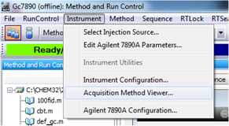
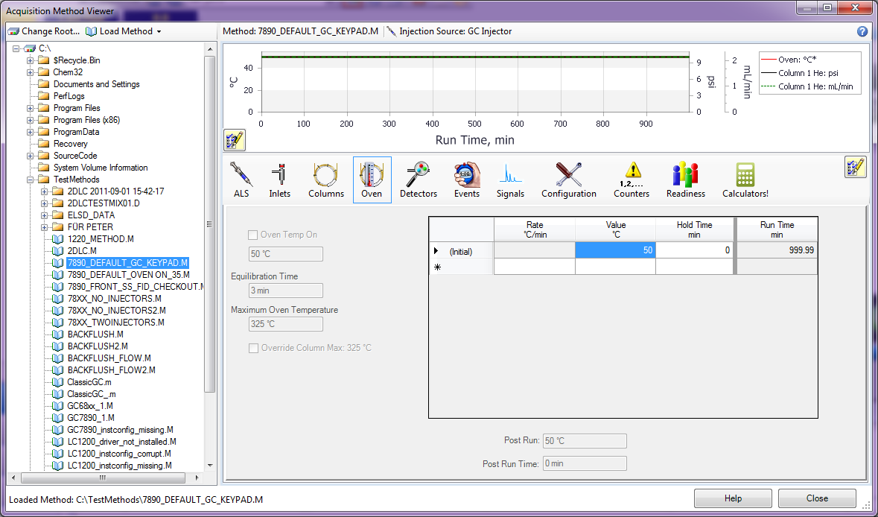
Acquisition Method Viewer ChemStation Edition
Problem
I need to review the Acquisition Method parameters before downloading to the instrument. I do not want to trigger Method Resolution.
Solution
Acquisition Method Viewer-provides a way to view the acquisition method parameters.

Slide 37
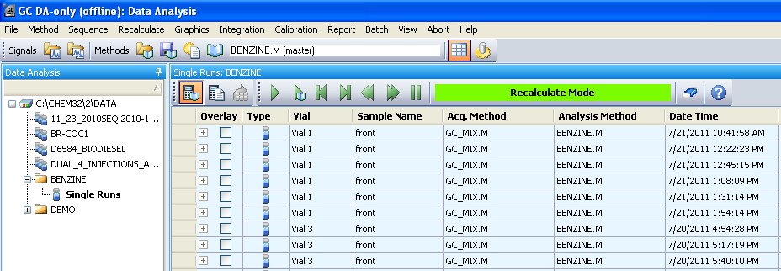
Single Sample Workflow (1/2) ChemStation Edition
The Navigation Table now shows the acquisition method as well as the data analysis method.
A fly-over indicates the path to the data analysis method.

Slide 38
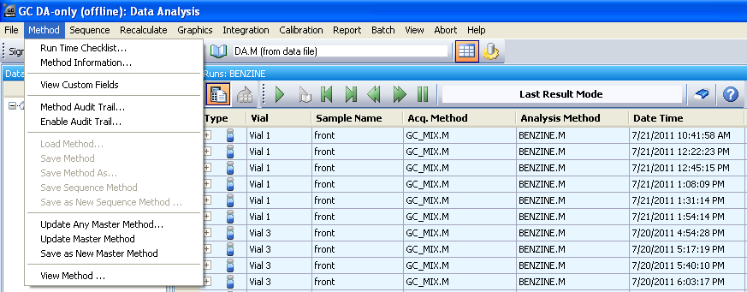
Single Sample Workflow (2/2) ChemStation Edition
In the Last Result Mode it is now possible to save the data analysis parameters last used (from DA.M) to a master method.
Update any master method with the data analysis parameters last used (from DA.M).
Update the corresponding master method with the data analysis parameters last used (from DA.M).
Combine the data analysis parameters last used (from DA.M) with acquisition parameters from any master method and save as a new master method.

Slide 39
AIC Virtualization: EZChrom Edition
Test and document topologies where parts of the system are deployed under VMware (either VMware workstation or VMware ESX).
Topology
EZChrom Edition Distributed System with ECM
Clients and AIC ‘s on a VMware ESX servers
Support statement: Supported and recommended
ECM or Data Store

Slide 40
OpenLAB CDS EZChrom Edition A.04.05
Online instrument will always remain in Monitor mode. When “Result Set” is opened at the end of Single/Sequence run the Instrument will remain in Monitor mode.
In “Result Review Mode” when a user opens a method, the last opened method and sequence file, if available, will be kept open/opened rather than being set to un-assigned while closing the “Result Set”.
Display and positioning of windows for instrument setup values and instrument curves is now persisted.
Option to select Local Time or UTC in exported reports.
Display instrument curves on IR report.
Update signal displayed in the online plot automatically whenever a method is downloaded to the instrument.
API support for automation of LC driver: Set instrument parameters from a 3rd party application (for e.g., flow rate, solvent composition) for Agilent LC driver.
Ability to lock a project to an instrument.
External Scripts Retained.

Slide 41
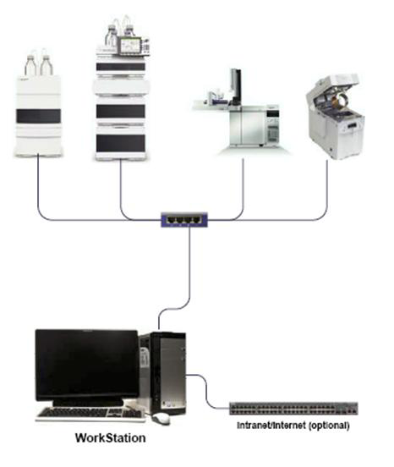
OpenLAB CDS - Workstations

Slide 42
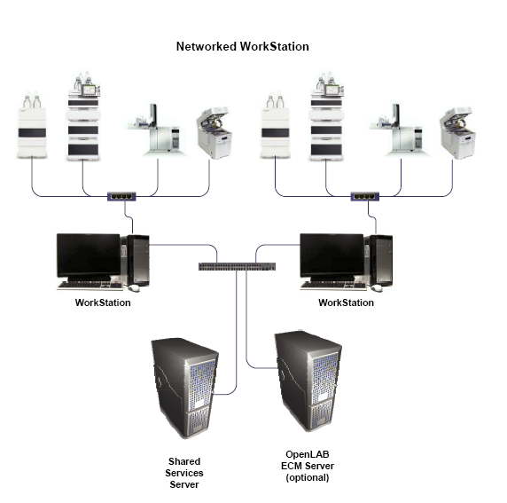
OpenLAB CDS – Networked Workstations

Slide 43
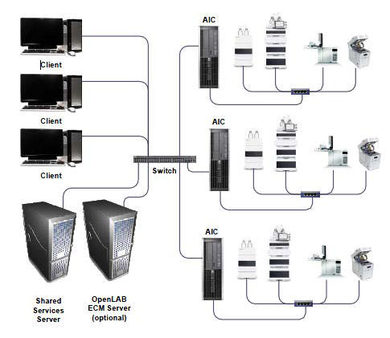
OpenLAB CDS – Distributed System

Slide 45
Deployment Changes

Slide 46
Better migration support: Mixed versions on one ECM
ChemStation rev. B/ OpenLAB CDS ChemStation Edition on one ECM
Support of ChemStation rev. B and OpenLAB CDS ChemStation Edition on one ECM system: With ChemStation rev. B and OpenLAB CDS rev. C on one ECM system, document limitations, e.g., the ability to reprocess ChemStation rev. B data in ChemStation rev. C, but not vice versa.
Mixed version clients on the latest OpenLAB Shared Services server
EZChrom: Software upgrades in mixed environments: In a Distributed or Networked environment, allow a "mixed version" of clients running with the latest OpenLAB Shared Services server to minimize downtime during an upgrade.

Slide 47
Agilent OpenLAB CDS New Data Analysis
Bringing you an Unique Data Analysis Experience!

Slide 48
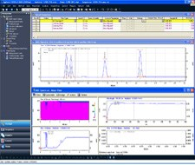
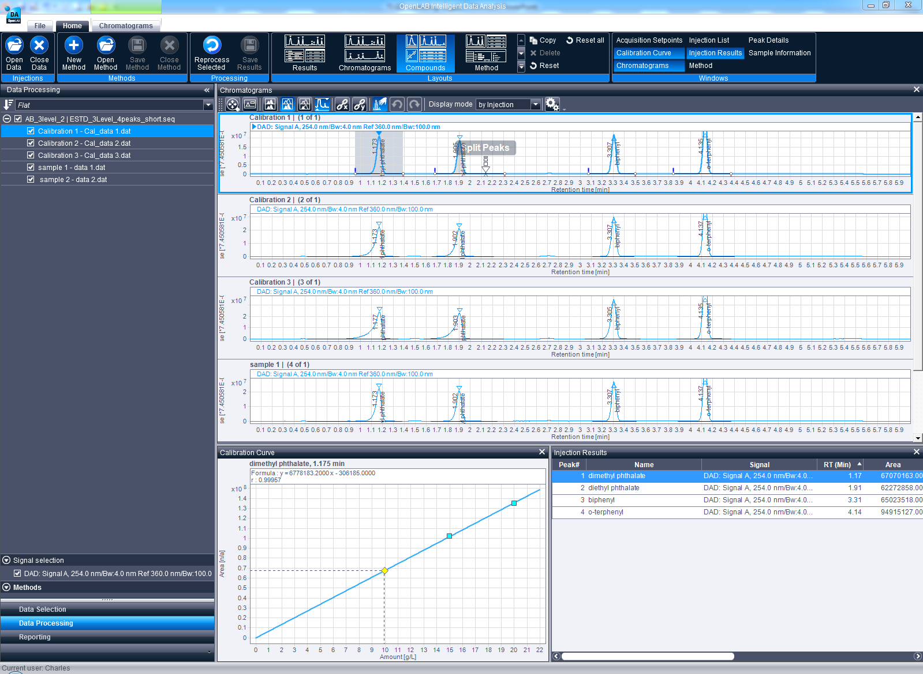
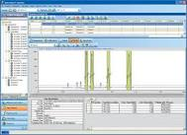
OpenLAB Data Analysis Benefits Works with OpenLAB EZChrom & ChemStation
EZChrom
Works with both platforms!
A single platform to learn
Use the same integration, calculation, calibration and reporting accross your laboratory
ChemStation
Notes:
Automatic processing is available from EE and CS editions. DA transparantly reads data files of both systems.
New introduced processing method (.pmx format) decouples acq method from processing method -> less methods to manage

Slide 49
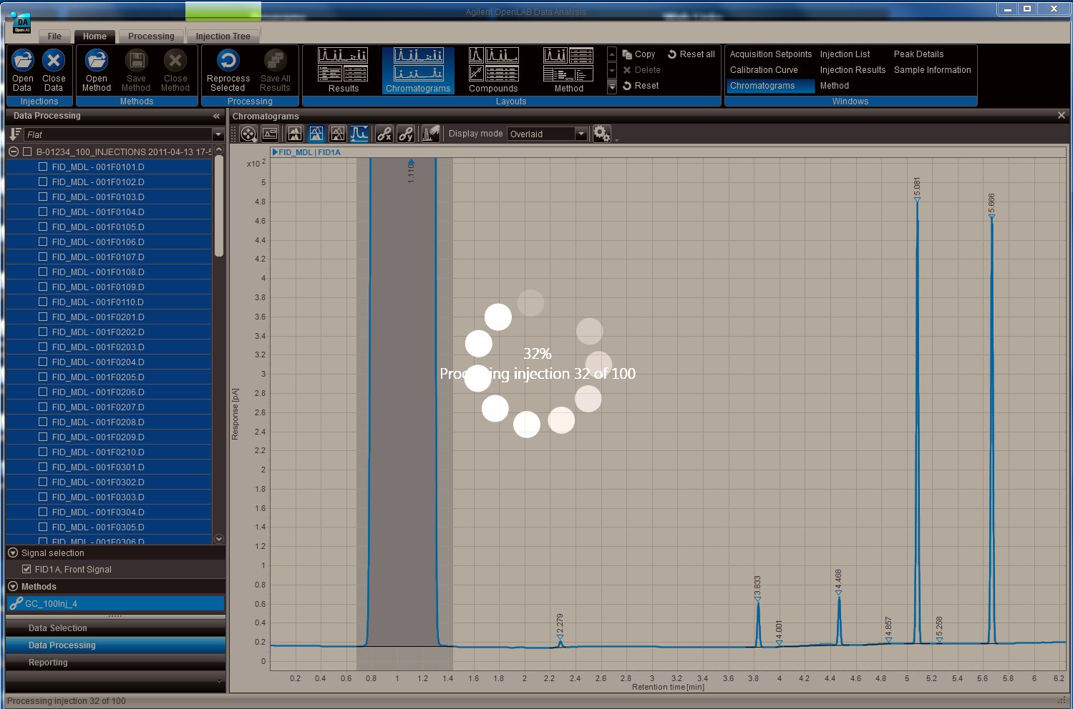
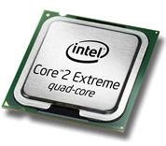
OpenLAB Data Analysis Design Performance
Fast, Faster, Fastest...
Focus on efficient data handling and memory usage
Architecture design supports asynchronous and parallel processing to exploit multi-core technology (incl. dynamic scaling)
Notes:
The DA uses the multi-core architecrure of modern PC’s. If possible processing of data is parallelized so multiple injections are processed at the same time.

Slide 50
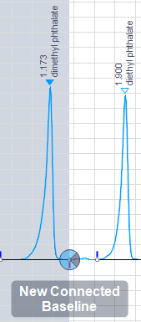
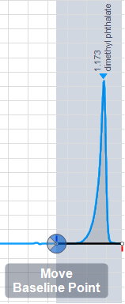
OpenLAB Data Analysis Benefits Smarter! Unique patented peak integration tool
Unique integration tool!
Fastest peak integration adjustment ever!
One instead of 30+ icons
Makes sample review fun again!
Revolutionary, patented one-click Manual Integration tool for fast review!
Notes:
The manual integration is the best of all CDS. As simple to use as a drawing program.
No toolbar buttons to remember – the integration tool is chosen automatically by the system when the user moves with the mouse across the integrated signal. Hints make learning easier. Configuraton can make it even simpler by turning off no-needed tools.
Tool has been patent in EU: EP 2098966B1

Slide 51
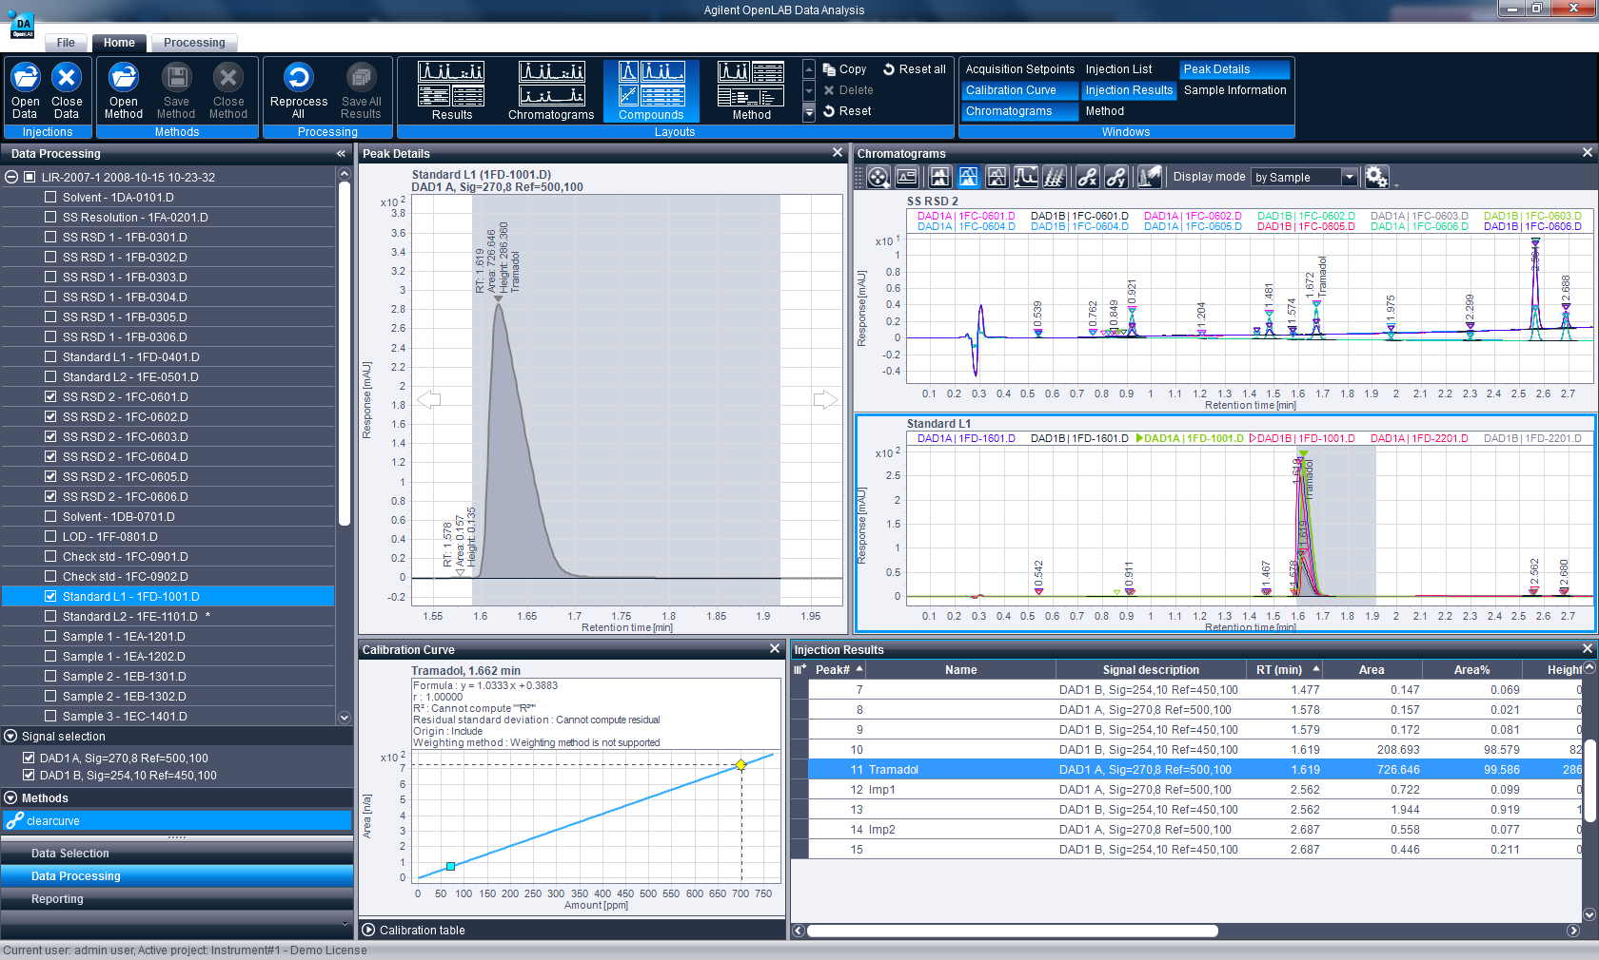
OpenLAB Data Analysis Benefits Easier! Designed by scientific software users
Function Ribbon
The Perfect User Interface
Flat interface
Usergroup validated
Direct access to main functions
MS Standard “Ribbon”
Less dialog boxes to close
“Flat” intuitive User Interface
Notes:
Note: UI also shows “company identity” – like our instrument hardware. Unlike Empower or Chromeleon which basically use standard UI themes the new DA really stands out in terms of UI design.
Use of the ribbon cleans up the since it combines tool bars and buttons in a singel element. Local toolbar buttons in the UI windows allow access to often used commands.
Flat UI is faster to use and looks more modern compared to multi-window UI’s. Less modal dialogs means less clicks.

Slide 52
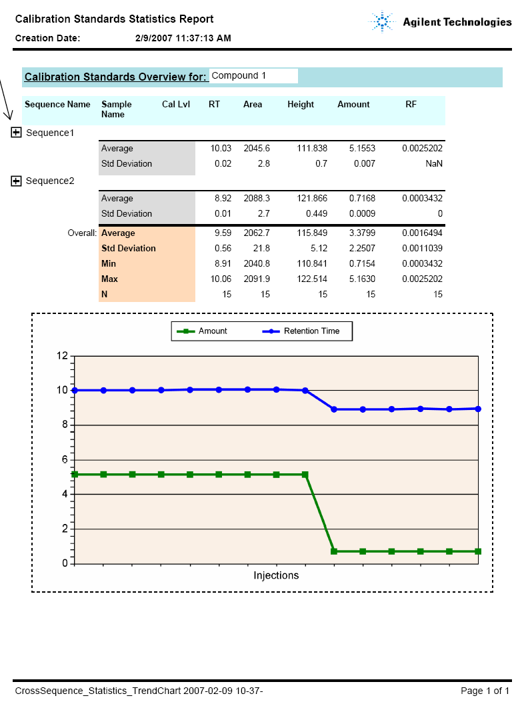
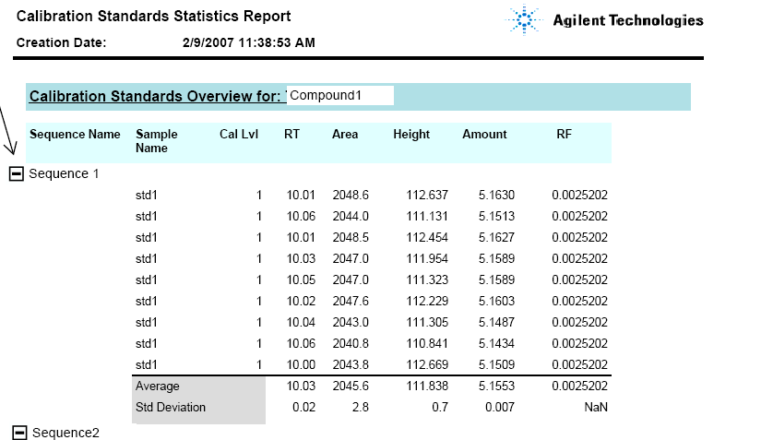
OpenLAB Data Analysis Benefits Infinitely Better Reporting!
Intelligent Reporting
Based on Microsoft’s reporting technologies
Templates use industry standard Report Definition Language
Provides extensive reporting capabilities for OpenLAB CDS
Improved usability through WYSIWYG report editor
Interactive report navigation for data review purposes
Notes:
All features of IR are available in teh new DA, from single injection to limited cross-sequence reporting
Templates can be exchanged with CS or EE editions

Slide 53
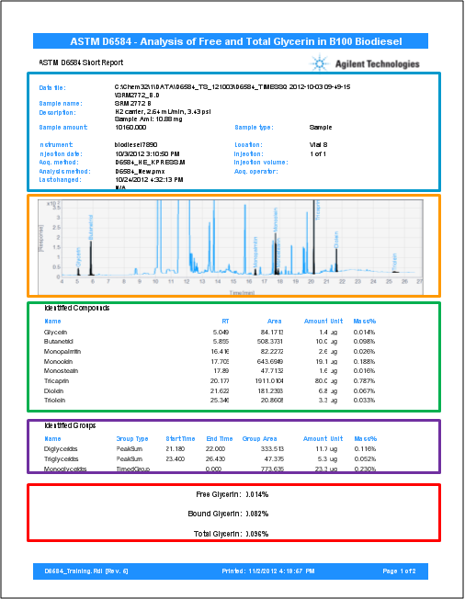
Intelligent Reporter
Custom Biodiesel Report
Sample Information
Sample chromatogram scaled to show only peaks of interest
Compounds reported by weight and weight % using custom calculations
Compound classes reported by weight and weight % using custom calculations
Normalized results according to ASTM formulas using custom calculations

Slide 54
Notes:
Step by step guide through the presentation

